Slide 1
Data Science for non Data Scientist

Slide 2
Outline
Data Science Definition
Components of Data Science
Statistic
Data Analysis & Visualization
Programming
Artificial Intelligence
Data Scientist Skills
Am I Data Scientist?
Where To start?
References

Slide 3
1-What is Data Science?
Data science is a multi-disciplinary field that uses scientific methods, processes, algorithms and systems to extract knowledge and insights from structured and unstructured data

Slide 4
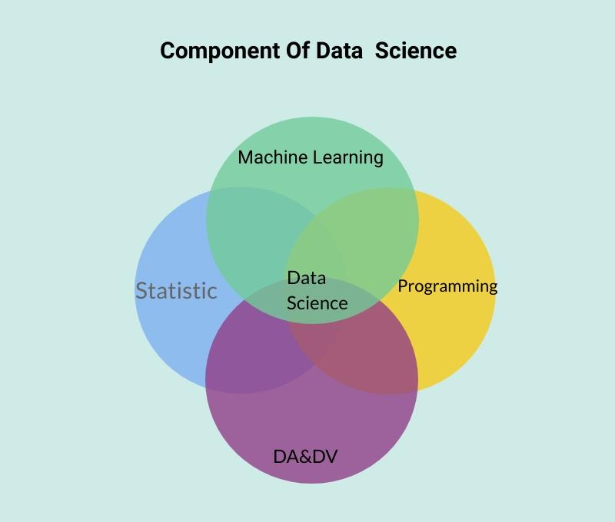
2-Components of Data Science

Slide 5
a- Statistics
Statistics is a mathematical science including methods of collecting, organizing and analyzing data in such a way that meaningful conclusions can be drawn from them.

Slide 6
a- Statistics(cont’d)
Descriptive statistics:
Describe data that have been collected.
Inferential Statistics :
Generalizing from samples to populations using probabilities.

Slide 7
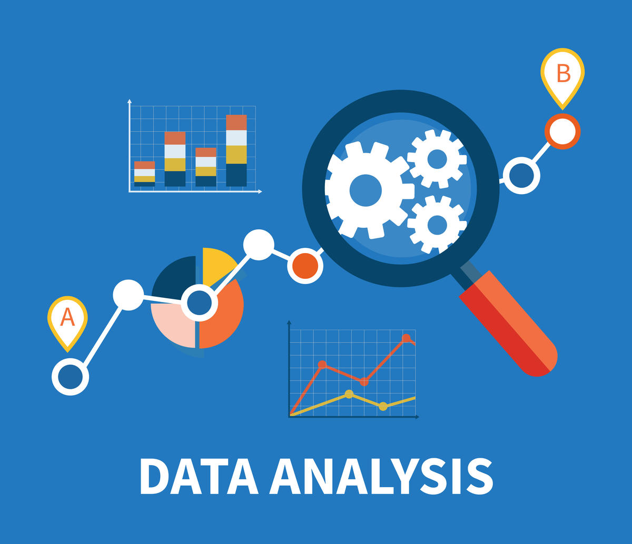
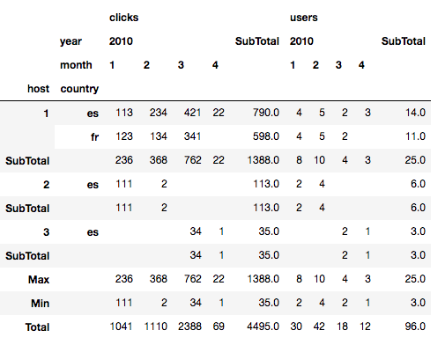
b-Data Analysis

Slide 8
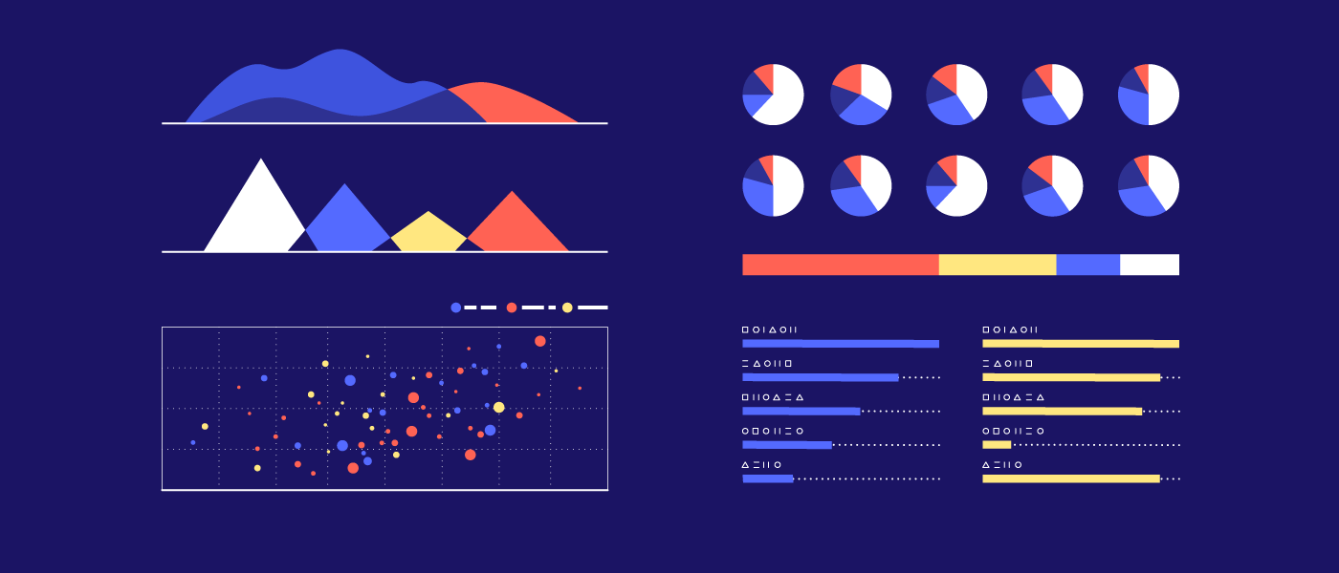
b-Data Visualization

Slide 9
c-Programming
Programming is the process of designing and building an executable computer program for accomplishing a specific computing task.

Slide 10
d-Artificial Intelligence
Artificial Intelligence is an area of computer science that emphasizes the creation of intelligent machines that work and react like humans.

Slide 11
Act rationaly

Slide 12
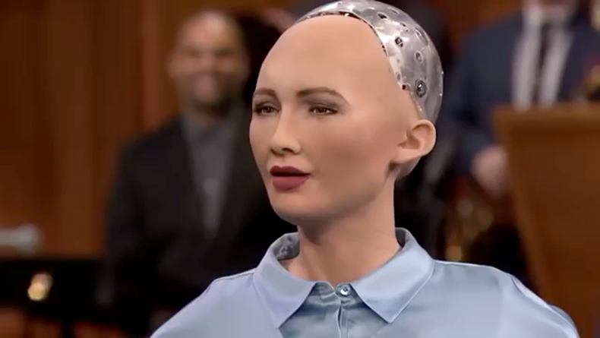
react like a people .

Slide 13
Artificial Intelligence (cont’d)
Machine Learning
Supervised learning
Unsupervised learning

Slide 14
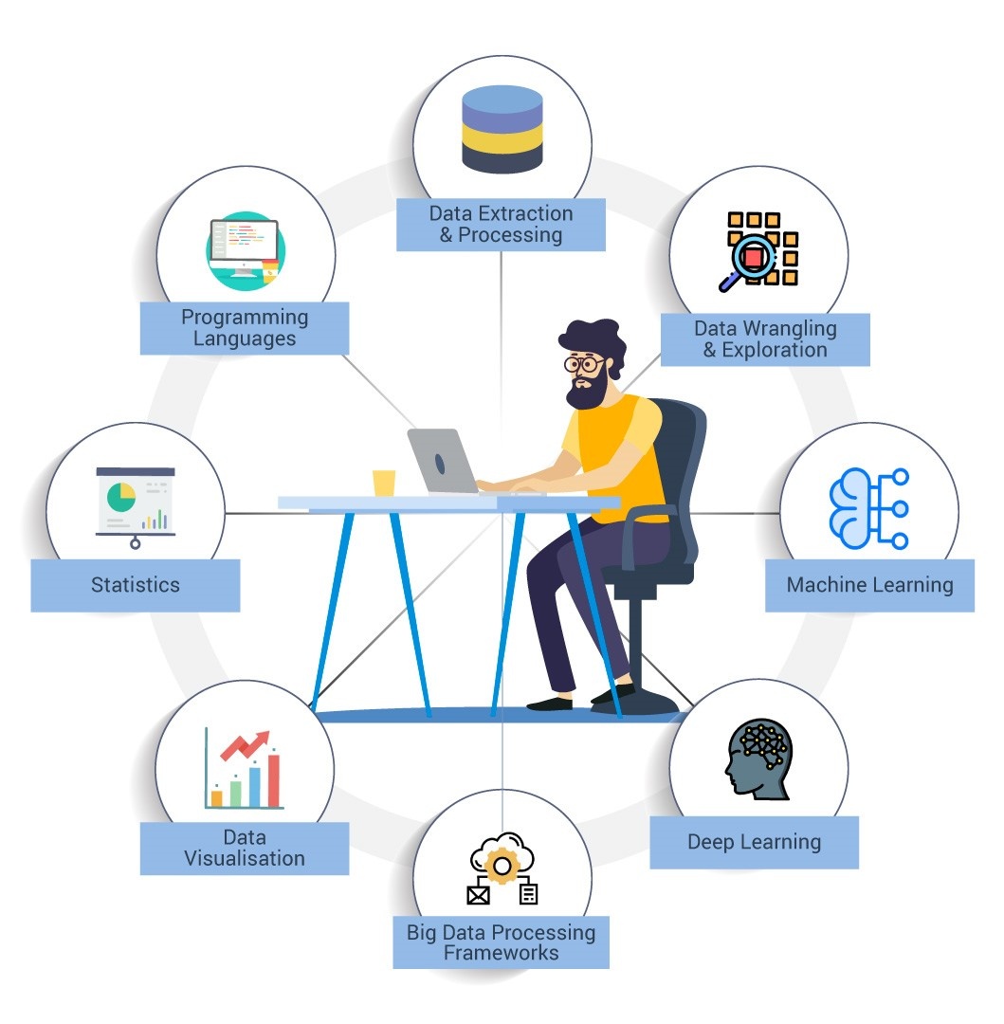
3-Data Scientist Skills

Slide 15

4-Am I Data Scientist?

Slide 16
Where to Start?
Introduction to Data Science مقدمة في علم البيانات:
https://www.youtube.com/watch?v=RWoe1jHCXUw&feature=youtu.be
Python https://www.udemy.com/course/complete-python-bootcamp/
Data Science: https://www.udemy.com/course/python-for-data-science-and-machine-learning-bootcamp/

Slide 17
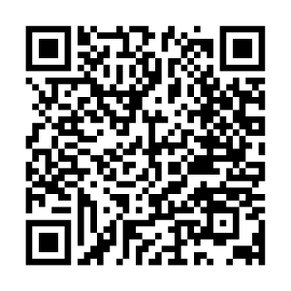
Slides PDF

Slide 18
References
https://en.wikipedia.org/wiki/Data_science
https://www.analyzemath.com/statistics/introduction_statistics.html
Probability & Statistics for Engineers & Scientists (9th Edition)
https://the-mis.org/wp-content/uploads/2018/03/Introduction-to-Data-Science.pdf
https://www.geeksforgeeks.org/supervised-unsupervised-learning/

Slide 19
Thank You !

Slide 20

@CsAbdulelah

